Slide 1
Chapter 4 Hashing Techniques
Chapter 4.3
Message Authentication Code

Slide 5

Classical way to build hash functions
Merkle-Damgård iterating mode
Instances: MD5, SHA-1, SHA-2 (224, 256, 384, 512) …

Slide 6
m = m₁ m₂ m₃ m_{s}
X h_{k}(m)
k X
f
f
f
…
f
h(m)
IV
m_{s+1}
f
h_{k}(m) h_{k}(m||m_{s+1})

Slide 8
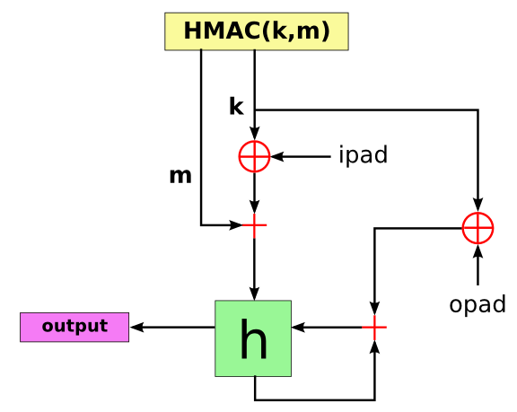

Slide 10
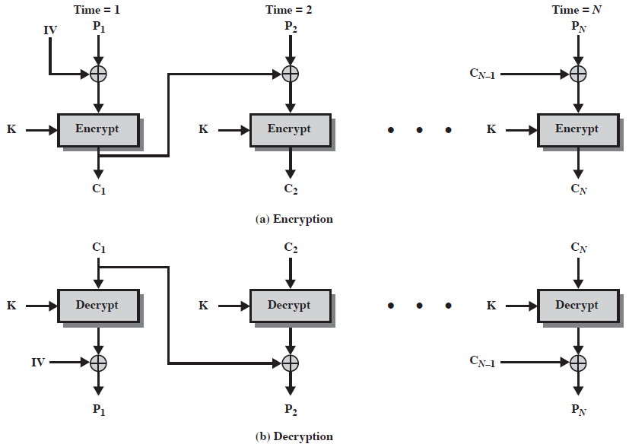
Cipher Block Chaining (CBC)

Slide 11
k₁,k₂
k₁)

Slide 12
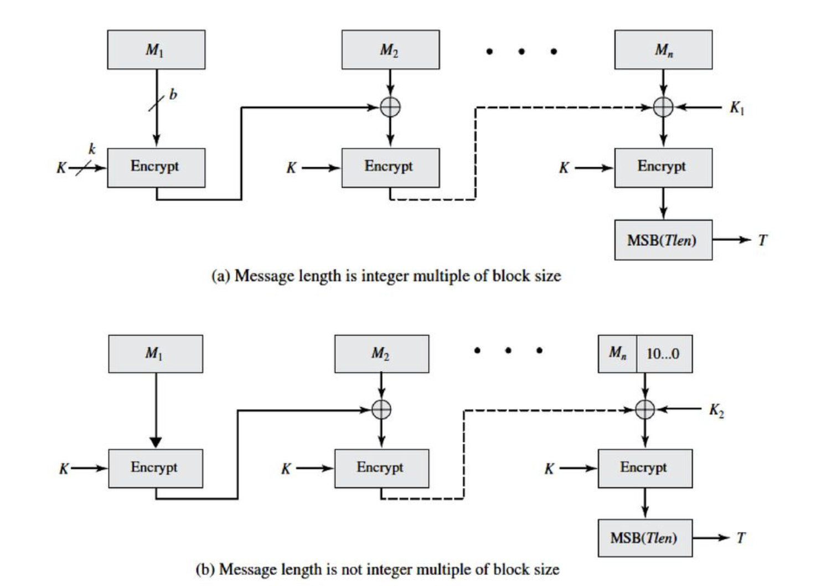
CMAC

Slide 13
Chapter 5 Key Management and Distribution
Chapter 5.1
Simplified Kerberos

Slide 14
Key Distribution
Have network with n entities
Add one more
Must generate n new keys
Each other entity must securely get its new key
Big headache managing n(n-1)/2 keys!
One solution: use a central keyserver
Needs n secret keys between entities and keyserver
Generates session keys as needed
Notes:
Note that a network with n entities has O(n^2) keys. Question: what ways could you handle distributing new keys?

Slide 15
Key Distribution Center (KDC)
Alice, Bob need shared symmetric key.
KDC: server shares different secret key with each registered user (many users)
Alice, Bob know own symmetric keys, K_{A-KDC} K_{B-KDC} , for communicating with KDC.

Slide 16
What is Kerberos?
Kerberos is a network authentication protocol. It is designed to provide strong authentication for client/server applications by using secret-key cryptography.
https://www.youtube.com/watch?v=VpBCJ8vS7T0

Slide 17
Kerberos History
Designed as part of MIT’s Project Athena in the 1980’s
Kerberos v4 published in 1987
Migration to the IETF
RFC 1510 (Kerberos v5, 1993)
Used in a number of products
Example: part of Windows 2000
MS Passport is essentially Kerberos
Notes:
Windows uses Microsoft Passport to authenticate users and help them to access protected resources and services.

Slide 18
Kerberos
Designed for single “administration domain” of machines & users: users, client machines, server machines, and the Key Distribution Center (KDC)
No public key crypto
Provides key management, authentication & encryption services
“Kerberized” servers provide authorization on top of the authenticated identities

Slide 19
Simplified Kerberos Model
Clients
Servers
The Authentication Server (AS)
Centralized trust model
AS is trusted by all clients & servers
AS shares a secret, symmetric key with each client and server

Slide 20


Picture of Simplified Kerberos
Authentication Server (AS)
(Database: K_{C},K_{S})
Server K_{S}
Client K_{C}

Slide 21
Kerberos Credentials
Two types of credentials in Kerberos
Tickets
Authenticators
Tickets are credentials issued to a client for communication with a specific server
Authenticators are additional credentials that prove a client knows a key at a point in time

Slide 22
Simplified Kerberos Protocol
Assume client C wishes to authenticate to and communicate with server S
Phase 1: C gets a Ticket from the AS
Phase 2: C communicates with S

Slide 23
Protocol Definitions
C = client
S = server
TGS = ticket-granting service
K_{x} = x’s secret key
K_{x,y} = session key for x and y
{m}K_{x} = m encrypted in x’s secret key
T_{x,y} = x’s ticket to use y
A_{x,y} = authenticator from x to y
n_{x} = a nonce generated by x

Slide 24
Simplified Kerberos Protocol (1)
Phase 1: C gets a Ticket from AS for S
C sends a request to the AS for S
A ticket is used to talk to S
A ticket is relatively long-lived (8-24 hours typically)
C ➔ AS: C, S, Lt, n_{C}
where Lt denotes lifetime.
Sent in the clear!

Slide 25
Simplified Kerberos Protocol (2)
Phase 1: C gets a Ticket from AS for S
AS responds with two items
A ticket
A ticket for C to talk to S
A copy of the session key to use to talk to S, encrypted in C’s shared key
AS ➔ C: {K_{C,S}, S, Lt, n_{C} ...}K_{C} , {T_{C,S}}K_{S}
where T_{C,S} = {K_{C,S}, C, Lt … }
Only the S can decrypt the ticket
C can unlock the first part to retrieve K_{C,S}

Slide 26
Picture of Simplified Kerberos
Authentication Server (AS)
AS ➔ C: {K_{c,s}, S, Lt, n_{C} …}K_{C}, {T_{C,S}}K_{S}
where T_{c,s} = {K_{c,s}, C, Lt …}
C ➔ AS: C, S, Lt, n_{C}
Client

Slide 27
Simplified Kerberos Protocol (3)
Phase 2: C communicates with S
C sends the ticket to S along with an authenticator to establish a shared secret
C ➔ S: {C, ts, sk …}K_{C,S} , {T_{C,S}}K_{S}
where A_{c,s} = {C, ts, sk …}K_{c,s}
ts - a timestamp, sk - a session key
S decrypts the ticket T_{C,S} to get the shared secret K_{C,S} needed to communicate securely with C

Slide 28
Simplified Kerberos Protocol (4)
Phase 2: C communicates with S
S decrypts the ticket to obtain the K_{C,S} and replies to C with proof of possession of the shared secret (optional step)
S ➔ C: {ts, sk …}K_{c,s}
Notice that S had to decrypt the authenticator, extract the timestamp & session key, and re-encrypt the timestamp & session key with K_{c,s}

Slide 29
Picture of Simplified Kerberos
C ➔ S: {C, ts, sk … }K_{C,S} , {T_{C,S}}K_{S}
where A_{c,s} = {C, ts, sk … }K_{c,s}
Server
Client
{ts, sk …}K_{c,s} : C ← S

Slide 30
Chapter 5 Key Management and Distribution
Chapter 5.2
Kerberos

Slide 31
Kerberos Model
Clients
Servers
The Key Distribution Center (KDC)
Ticket Granting Server (TGS)
Centralized trust model
KDC is trusted by all clients & servers
KDC shares a secret, symmetric key with each client and server

Slide 32
Picture of Kerberos
Key Distribution
Center (KDC)
(Database: K_{C},K_{TGS})
Ticket Granting Server (TGS)
(Database: K_{TGS,}K_{S})
Server K_{S}
Client K_{C}

Slide 33
Kerberos Protocol
Assume client C wishes to authenticate to and communicate with server S
Phase 1: C gets a Ticket-Granting Ticket (TGT) from the KDC
Phase 2: C uses the TGT to get a Ticket for S
Phase 3: C communicates with S

Slide 34
Kerberos Protocol (1)
Phase 1: C gets a Ticket-Granting Ticket
C sends a request to the KDC for a “ticket-granting ticket” (TGT)
A TGT is a ticket used to talk to the special ticket-granting service
A TGT is relatively long-lived (8-24 hours typically)
C ➔ KDC: C, TGS, Lt, n_{C}
Sent in the clear!

Slide 35
Kerberos Protocol (2)
Phase 1: C gets a Ticket-Granting Ticket
KDC responds with two items
The ticket-granting ticket
A ticket for C to talk to TGS
A copy of the session key to use to talk to TGS, encrypted in C’s shared key
KDC ➔ C: {K_{C,TGS}, TGS, Lt, n_{C}}K_{C} ,{T_{C,TGS}}K_{TGS}
where T_{C,TGS} ={K_{C,TGS}, C, Lt …}
Only the TGS can decrypt the ticket
C can unlock the first part to retrieve K_{C,TGS}

Slide 36
Picture of Kerberos
Key Distribution
Center (KDC)
C ➔ KDC: C, TGS, Lt, n_{C}
KDC ➔ C: {K_{C,TGS}, TGS,Lt, n_{C}}K_{C} , {T_{C,TGS}}K_{TGS}
where T_{C,TGS} = {K_{C,TGS}, C, Lt …}
Client

Slide 37
Kerberos Protocol (3)
Phase 2: C gets a Ticket for S
C requests a ticket to communicate with S from the ticket-granting service (TGS)
C sends TGT to TGS along with an authenticator requesting a ticket from C to S
C ➔ TGS: {ts …}K_{C,TGS} , {T_{C,TGS}}K_{TGS}, S, Lt, n_{C}
First part proves to TGS that C knows the session key
Second part is the TGT that C got from the KDC

Slide 38
Kerberos Protocol (4)
Phase 2: C gets a Ticket for S
TGS returns a ticket for C to talk to S
(Just like step 2 above...)
TGS ➔ C: {K_{C,S}, S, Lt, n_{C}}K_{C,TGS},{T_{C,S}}K_{S}
Only S can decrypt the ticket
C can unlock the first part to retrieve K_{C,S}

Slide 39
Picture of Kerberos
Ticket Granting Server (TGS)
C ➔ TGS: = {ts …}K_{C,TGS}, {T_{C,TGS}}K_{TGS},
S, Lt, n_{C}
TGS ➔ C: {K_{C,S}, S, Lt, n_{C}}K_{C,TGS} , {T_{C,S}}K_{S}
Client

Slide 40
Kerberos Protocol (5)
Phase 3: C communicates with S
C sends the ticket to S along with an authenticator to establish a shared secret
C ➔ S: {C, ts, sk…}K_{C,S}, {T_{C,S}}K_{S}
where A_{c,s} = {C, ts, sk, …}K_{c,s}
S decrypts the ticket T_{C,S} to get the shared secret K_{C,S} needed to communicate securely with C

Slide 41
Kerberos Protocol (6)
Phase 3: C communicates with S
S decrypts the ticket to obtain the K_{C,S} and replies to C with proof of possession of the shared secret (optional step)
S ➔ C: {ts, sk,…}K_{c,s}
Notice that S had to decrypt the authenticator, extract the timestamp & session key, and re-encrypt those two components with K_{c,s}

Slide 42
Picture of Kerberos
C ➔ S: {C, ts, sk, …}K_{C,S} , {T_{C,S}}K_{S}
where A_{c,s} = {C, ts, sk, …}K_{c,s}
Server
Client
S ➔ C: {ts,sk, …}K_{c,s}

Slide 43
Picture of Kerberos
Key Distribution
Center (KDC)
Ticket Granting Server (TGS)
Ticket Request
TGT Request
TGT
Ticket
Ticket + service request
“Do some stuff”
Server
Client

